Slide 1
TAFJ – Introduction and Eclipse
July 2014
Notes:
© 2006 Capgemini - All rights reserved
0

Slide 2
What is TAFJ?
TAFJ is a Pick BASIC runtime and compiler.
The runtime itself has been developed using java
The compiler converts standard jBC code to java byte code
It manages connectivity to JDBC compliant databases.
Eg: Oracle, DB2, DERBY,H2 etc
It comes with tools that helps us to migrate multivalue data to Oracle,H2,Derby etc.
Notes:
Temenos Application Framework Java, simply known as TAFJ, is a Pick BASIC runtime compiler
What is a Pick BASIC runtime and compiler?
Pick is a hash file data management system. BASIC is a programming language.
A Pick-BASIC runtime is a system that runs on Pick Data management system and has BASIC as the coding language. jBASE is a database based on the Pick system and hence supports multi-values and uses a hash file management system. The jBase runtime known as TAFC (Temenos Application Framework C) allows users to develop applications using a flavour of Basic known as jBC . jBC code is internally converted to C code. Yes, you guessed right, this is why the runtime is called as TAFC.
So what’s TAFJ then? It’s an alternative for TAFC. It was developed in java, and the compiler provided with TAFJ converts jBC code to java.
What about databases? Does TAFJ use only jBase? No, it since it is java based, it uses JDBC, and can connect to any JDBC compliant database such as Oracle, jBASE, Derby, H2, SQL Server or DB2.
TAFJ also comes with a tool to migrate jBase multi-value data to Oracle,H2,Deby etc.

Slide 3
Why TAFJ
Notes:
TAFJ has been developed to replace jBASE as a runtime and development environment for T24. TAFJ allows us to run T24 on java.

Slide 4
T24 Java Technology
T24 Java Main Features
T24 Java: T24 compiled to byte-code (class file) that can run on any JVM regardless of computer architecture
Platform independent (any can OS have a JRE)
T24 based on TAFJ
T24 Implementation
All developments exclusively done in jBC (that generates java) or pure Java
(for Local Developments)
T24 Connectivity
Database independent (uses JDBC)
Notes:
T24 Java Main Features
T24 Java: T24 compiled to byte-code (class file) that can run on any Java Virtual Machine(JVM) regardless of computer architecture
Platform independent (any can OS have a JRE (Java Runtime Environment))
T24 based on TAFJ (Temenos Application Framework Java)
T24 Implementation
All developments exclusively done in jBC (that generates java) or pure Java
(for Local Developments)
T24 Connectivity
Database independent (uses JDBC (Java Data Base Connectivity))
Restriction : (Java Store Functions , XML Type)
File System independent (IO Daemon Server)

Slide 5
Architecture
Notes:
TAFJ has been developed to replace jBASE as a runtime and development environment for T24. TAFJ allows us to run T24 on java.

Slide 6
Architecture – Till R09
Client
Web Browser
Web Browser
Web Browser
Web Browser
Http Request
Network Dispatcher
Http Response
Web Server Layer (Presentation Layer)
Web Server
Tomcat / WebSphere / Oracle application Server
T24 Browser
TCC (Temenos Connector Client)
Web Server
Tomcat / WebSphere / Oracle application Server
T24 Browser
TCC (Temenos Connector Client)
Web Server
Tomcat / WebSphere / Oracle application Server
T24 Browser
TCC (Temenos Connector Client)
BrowserXML Request
MQ Server
IBM MQ / Sun MQ etc
BrowserXML Response
T24 Application Server Layer
T24 Server
TCS (Temenos Connector Server)
T24 with OFS
JEDI driver & jBASE
T24 Server
TCS (Temenos Connector Server)
T24 with OFS
JEDI driver & jBASE
Database Server Layer
Database Server
Oracle / DB2 / MS SQL / jBASE
Database Server
Oracle / DB2 / MS SQL / jBASE
Database Server
Oracle / DB2 / MS SQL / jBASE

Slide 7
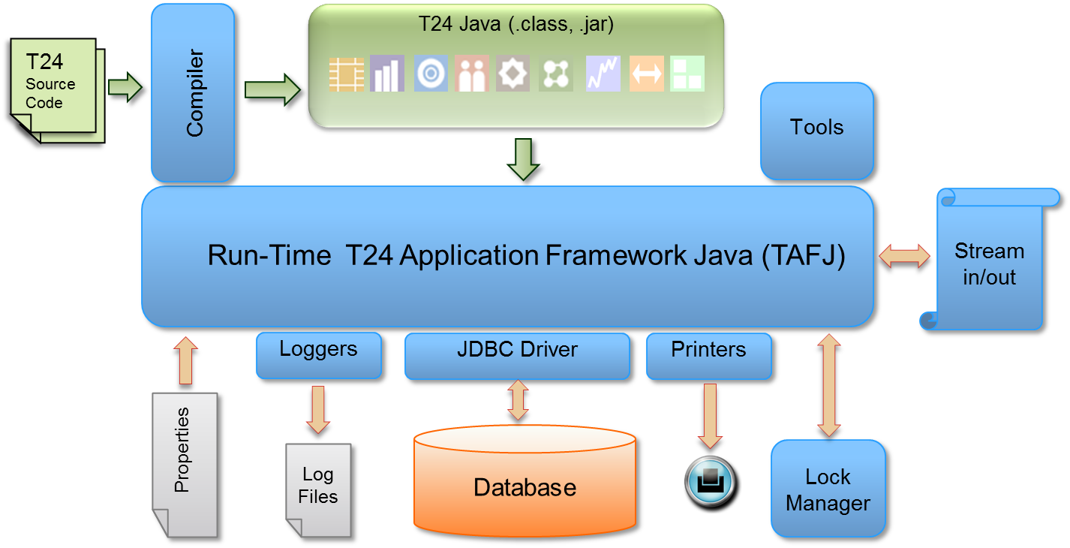
TAFJ-Architecture
Notes:
This architecture shows T24 on Java with the TAFJ runtime. TAFJ has it’s own JBC compiler plus a set of tools.
T24 code, written in JBC, would have been converted to java classes and packaged in jars. This code is deployed on TAFJ.
You can configure the TAFJ framework using ‘properties” files. Properties files are text based, and use a property name=value syntax.
Eg: temn.tafj.jdbc.jbase.utf8 = false
TAFJ supports logging using a standard log4j mechanism.
The TAFJ Framework provides connectivity via JDBC drivers to JDBC compliant databases. TAFJ provides it’s own lock manager to manage locking on databases.

Slide 8
TAFJ
Notes:
TAFJ uses only free and open source software's for all 3rdparty requirements, like H2, jBoss, JDK, eclipse etc. The competitive advantage that an OSS gives by allowing customization of code to suit our company’s needs is a significant reason for using them in addition to the low cost of ownership. A T24 on TAFC requires renewal of T24 as well as MSVC licenses, whereas Java is free. Support for other contemporary market technologies is easier with TAFJ rather than TAFC. For example lets presume a client wants to use MySQL, another open source database instead of the officially supported ones. On a TAFC runtime, we have Direct connect drivers (DCD) for Oracle, SQL Server and DB2. Extensive programming effort is required to newly create a DCD for MySQL. Whereas on TAFJ, since we use JDBC drivers, its only a matter of very few lines of code to write for performance improvement.

Slide 9
ECLIPSE
Notes:
You will now learn about Eclipse and how it fits with TAFJ.

Slide 10
Eclipse
Eclipse is an Integrated Development Environment (IDE)
You will see how to customize Eclipse IDE for tafj needs
Eclipse software comes in a compressed format.
Eg. eclipse-SDK-3.3.1.1-win32.zip
You can download Eclipse from
http://www.eclipse.org/downloads
Installing Eclipse involves just extracting the compressed file
Extract the file as <tafj_home>\eclipse_tafj
Eg. D:\LocalHost\TAFJ\eclipse_tafj
Notes:
1.Eclipse is an Integrated Development Environment (IDE)
2.You will see how to customize Eclipse IDE for tafj needs
3.Eclipse software comes in a compressed format.
3.1.Example eclipse-SDK-3.3.1.1-win32.zip
4.You can download Eclipse from http://www.eclipse.org/downloads
5.Installing Eclipse involves just extracting the compressed file.
6.You should extract the file under <tafj_home>\eclipse_tafj
6.1.Example D:\LocalHost\TAFJ\eclipse_tafj

Slide 11
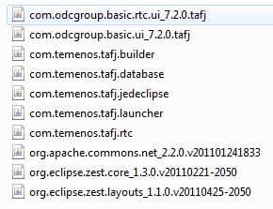
Setup Eclipse
To setup tafj Eclipse Builder, copy the four jar files present under <tafj_home>\ eclipse\plugins and put it under <eclipse_home>\plugins
To check if the tafj plugins are available for Eclipse, launch Eclipse and click on Help->About Eclipse SDK-> Plug-in Details
Notes:
1.To work with Eclipse, tafj comes with four plug-ins. You can find them under <tafj_home>\lib\plugins. Copy them and put it under <eclipse_home>\plugins.
2.To check if the plug-ins have been installed correctly, launch eclipse, go to “Help”, click “About Eclipse SDK” and then click “Plug-in Details”. Scroll down to check if the plug-ins are displayed.

Slide 12
Checks Before working with Eclipse
Now that your Eclipse is set for TAFJ, you will do some checks before working with it.
Start Eclipse.
Eclipse will ask a path for creating workspace, this is where the TAFJ projects will get created. Give a path like <tafj_home>\workspace, e.g. “D:\tafjtrng\TAFJ\Workspace”
Select Window->Preferences…->Java->Installed JRE’s
Check jdk1.6.0_17
Note: It is recommended to use jdk1.6.0_17 as this is the most compatible version of java for TAFJ.
Notes:
1.Before starting to work with Eclipse, you will do certain checks.
2.Launch your eclipse
3. Eclipse will ask a path for creating workspace, this is where the tafj projects will get created. Give a path like <tafj_home>\data, Example “D:\LocalHost\TAFJ\Workspace”
4.Select the “Window” menu, click on “Preferences…”, click on “Java”, and then select “Installed JRE’s”
4.1.Select “jdk1.6.0_17” as the required JRE
4.2.It is recommended to use jdk1.6.0_17 as this is the most compatible version of java for tafj.

Slide 13
Captivate slide
Demo – Working with Eclipse
Notes:
ECLIPSE DEMO

Slide 14
Clean Projects
Cleaning a project will involve
Deleting all java files
Deleting all class files
Compiling all BASIC files
To clean a project, click Project -> Clean
Choose a project to clean and click OK
Notes:
Lets consider a scenario where you wish to replace the old BASIC code with a new set of BASIC code, then you will remove the old BASIC files, and add your new BASIC files, then manually delete all the java source files and class files. After this, you will do a full build of the new code. Instead, you can remove the old BASIC files, add the new BASIC files and the do a project cleaning.
Cleaning a project will
Delete all java files
Delete all class files
Compile all BASIC files for you
To clean a project, click Project -> Clean
Choose a project to clean and click OK

Slide 15
Eclipse JED Editor
This is a simple plug-in that allows you to view and edit records in jBASE from eclipse.
To work with this Editor, you should have installed the “com.temenos.tafj.jedeclipse_1.1.0.jar” plug-in
Notes:
In jBASE when you wanted to view or edit a record, you used the JED editor. How will you view, modify and insert records with Eclipse?
TAFJ comes with a simple plug-in that allows you to view and edit records in jBASE from eclipse.
To work with this Editor, you should have installed the “com.temenos.tafj.jedeclipse_1.1.0.jar” plug-in

Slide 16
Outline View - Pre-requisites
Eclipse plug-ins
TAFJ Project
Slide 15
Notes:
15
To be able to work with Eclipse outline, the pre-requisites are the eclipse plugin and a project created under TAFJ.

Slide 17
Open file in outline view
Open basic code with TAFJ basic editor
Right click on file -> Open With -> other
Slide 16
Notes:
16
When you edit a basic file with TAFJ editor the out line view is opened automatically. The following screen shot will help with opening a Basic file with TAFJ basic editor.

Slide 18
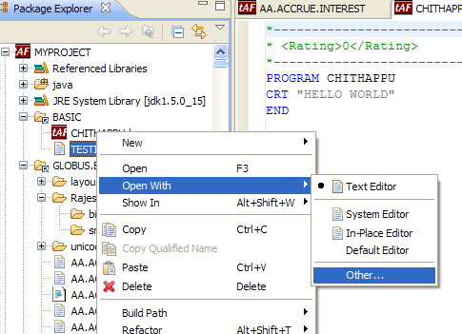
Open file in outline view
Slide 17
Notes:
17
Select “Basic Editor” from the window that pops up and press OK. Your basic file is now being edited in Eclipse Basic Editor.

Slide 19
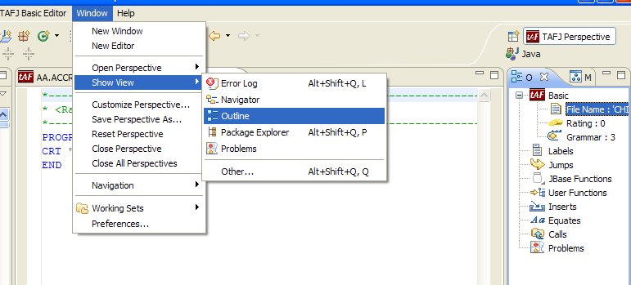
View Outline window
Slide 18
Notes:
18
On opening the file with Basic Editor in Eclipse, the outline window will be visible automatically. If not activate the window from Window -> Show View Option -> Outline in Eclipse.

Slide 20
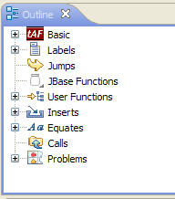
View Outline window
Slide 19
Notes:
19
The outline view represents a tree structure, branches with (+) symbol in the front can be expanded to display further contents under the branch.

Slide 21
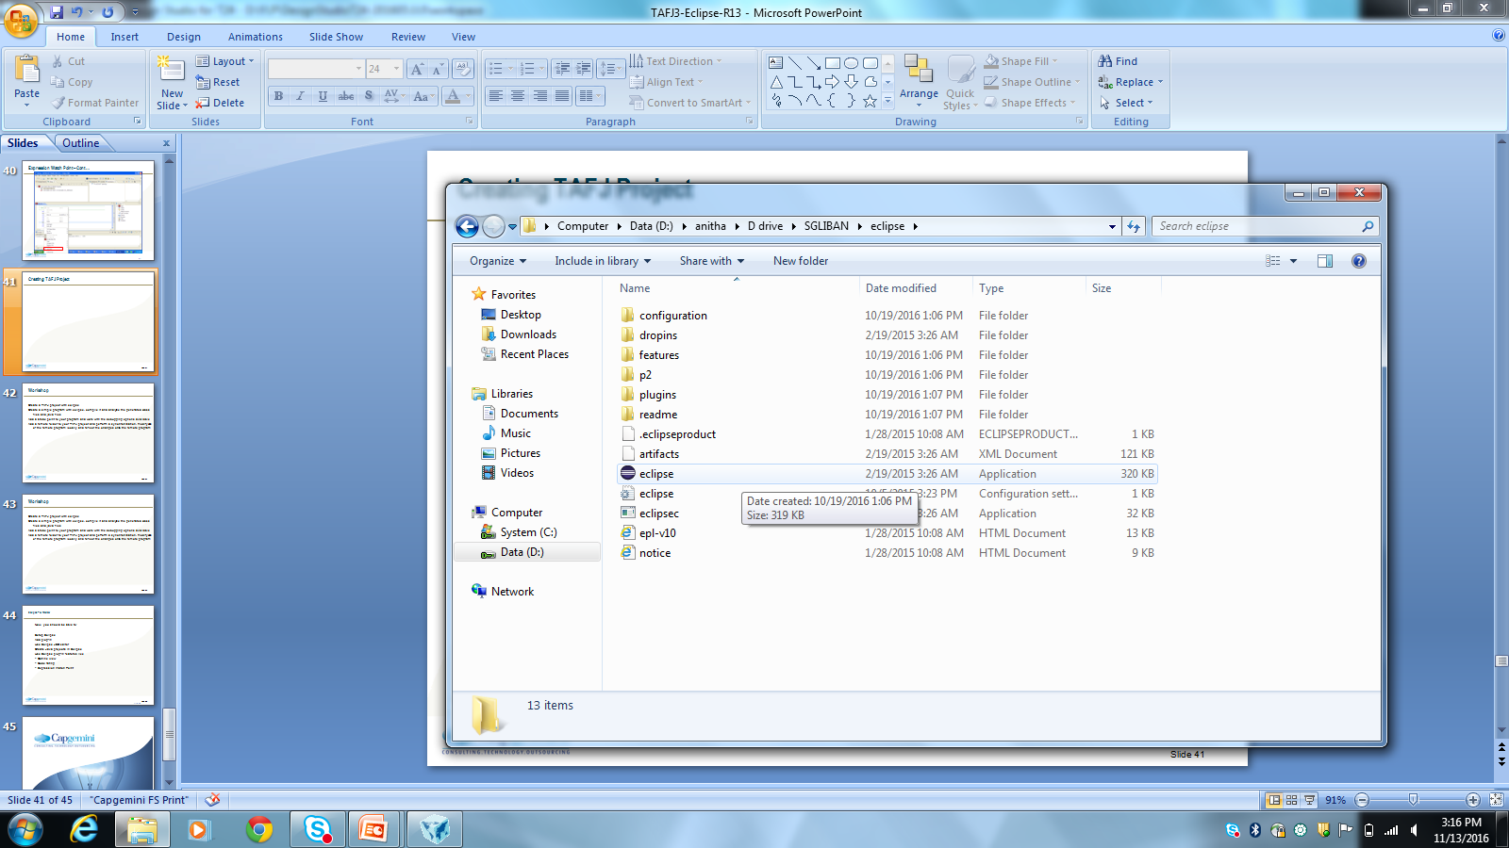
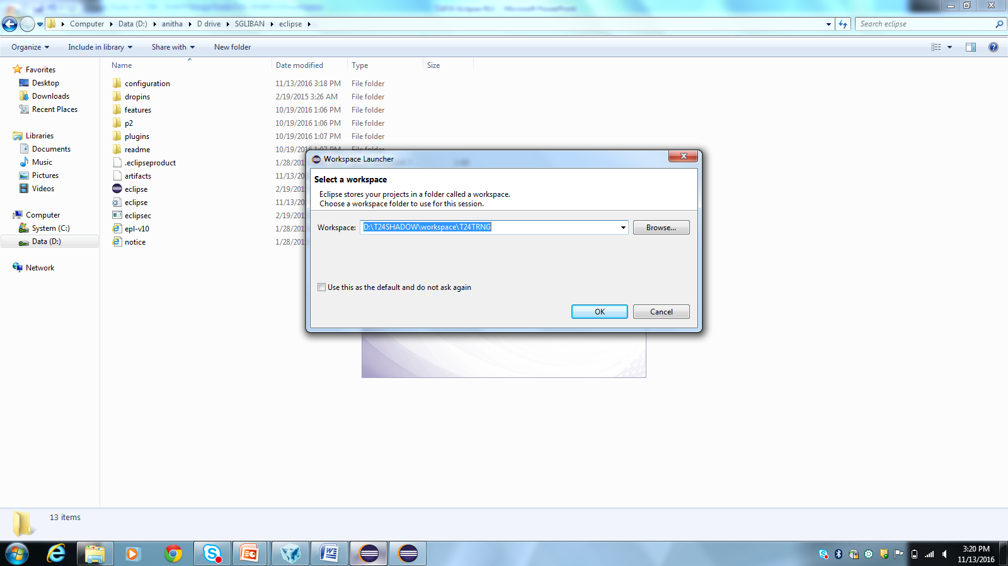
Creating TAFJ Project in Eclipse
Notes:
Create a TAFJ project with eclipse
Create a simple program with eclipse, compile it and analyze the generated class files and java files
Add a break point to your program and work with the debugging options available
Add a remote folder to your TAFJ project and perform a synchronization, modify one of the remote program locally and reflect the changes onto the remote program

Slide 22
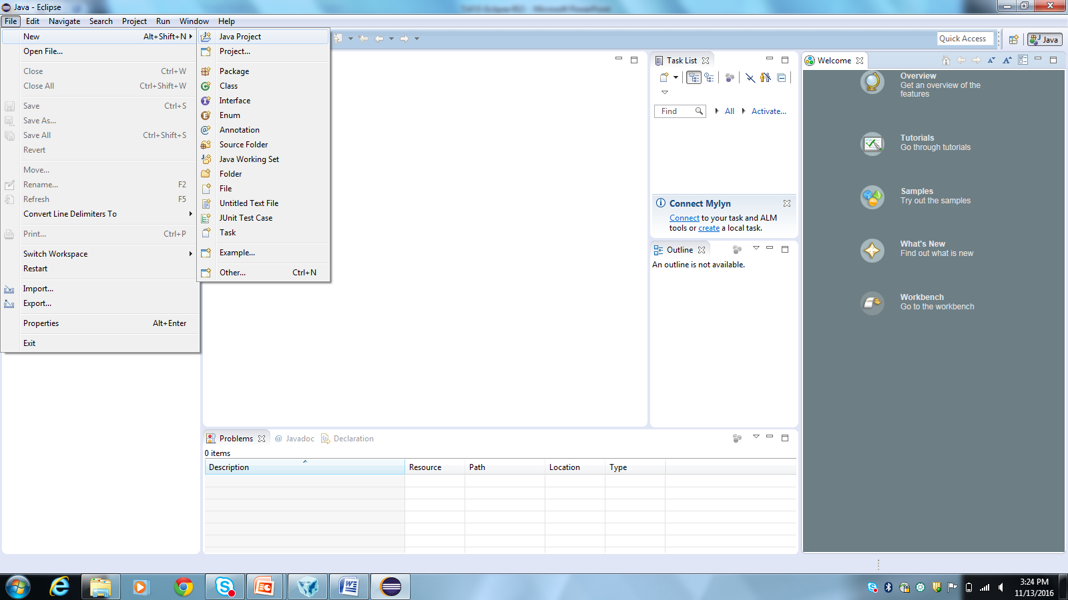
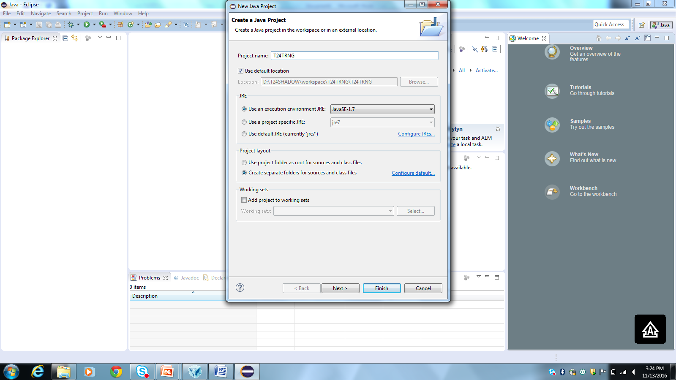
Creating TAFJ Project in Eclipse
Notes:
Create a TAFJ project with eclipse
Create a simple program with eclipse, compile it and analyze the generated class files and java files
Add a break point to your program and work with the debugging options available
Add a remote folder to your TAFJ project and perform a synchronization, modify one of the remote program locally and reflect the changes onto the remote program

Slide 23
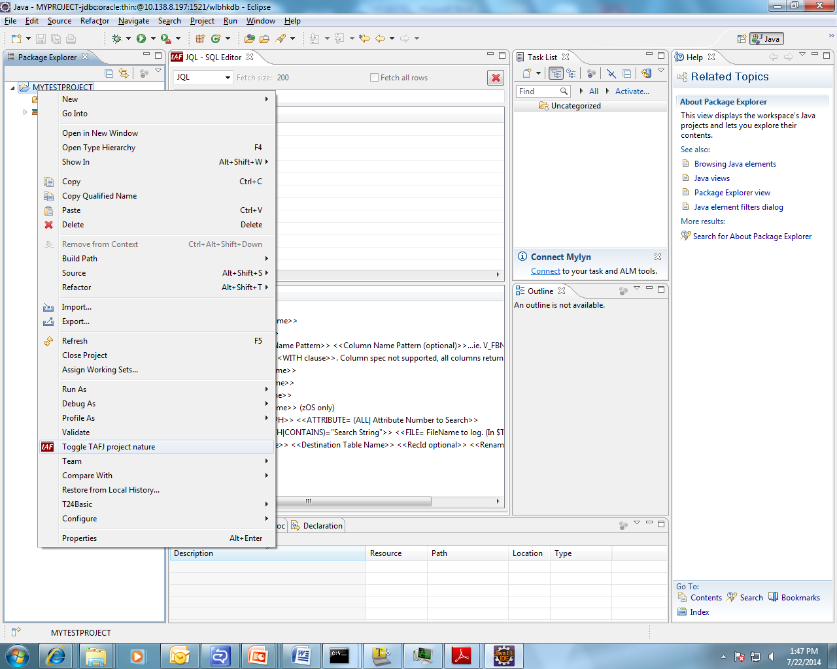
Eclipse

Slide 24
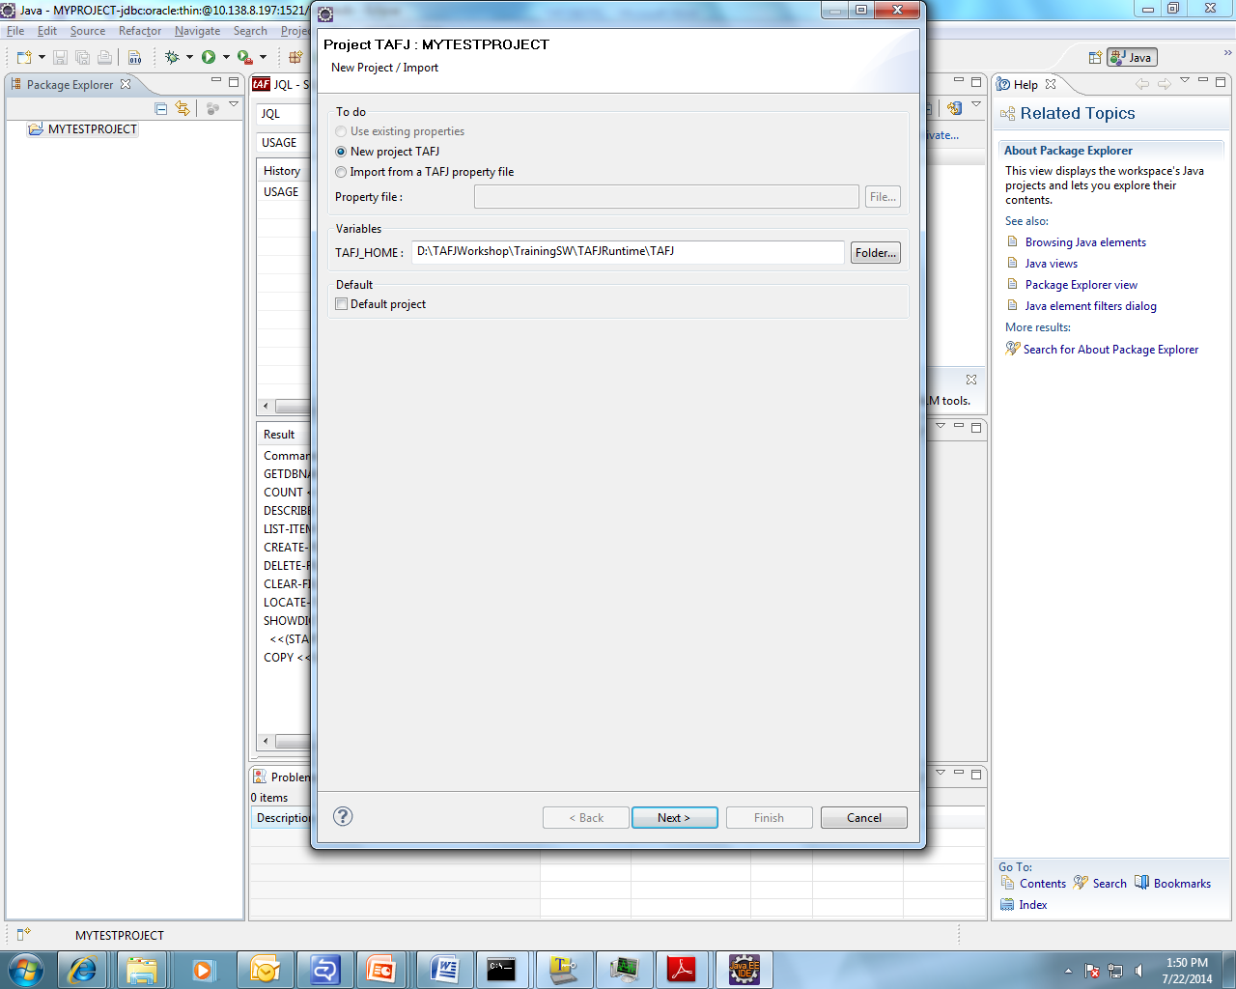
Eclipse
Specify the path of TAFJ Home

Slide 25
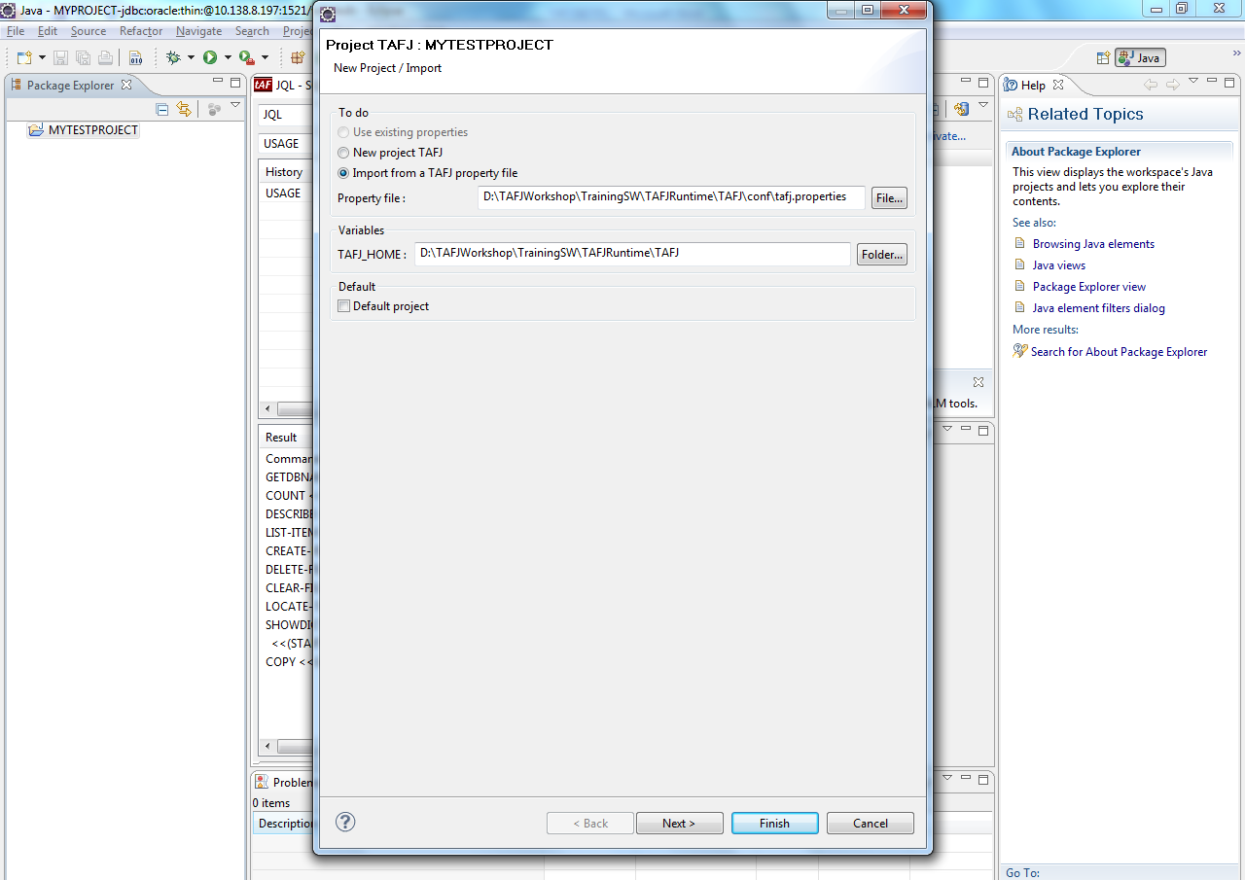
Eclipse
Specify path of tafj.properties file

Slide 26
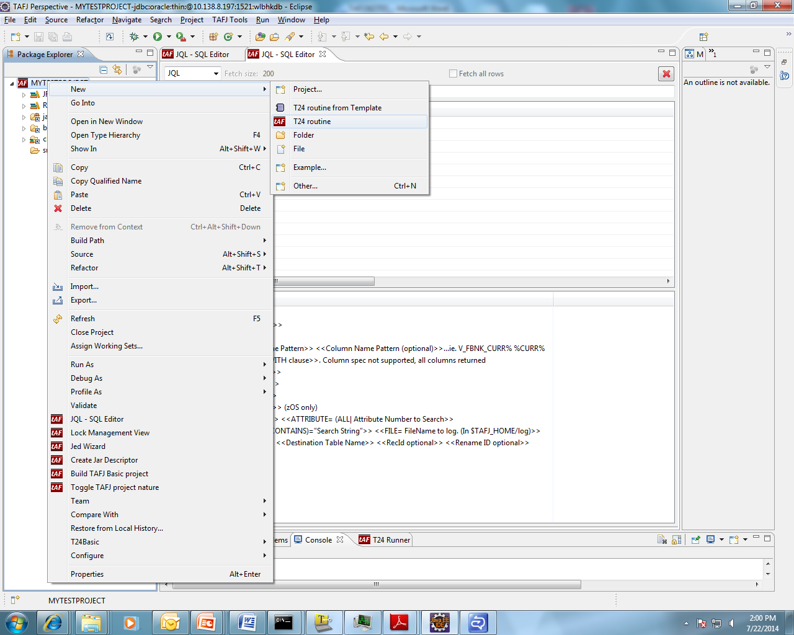
Eclipse – To write T24 routine

Slide 27
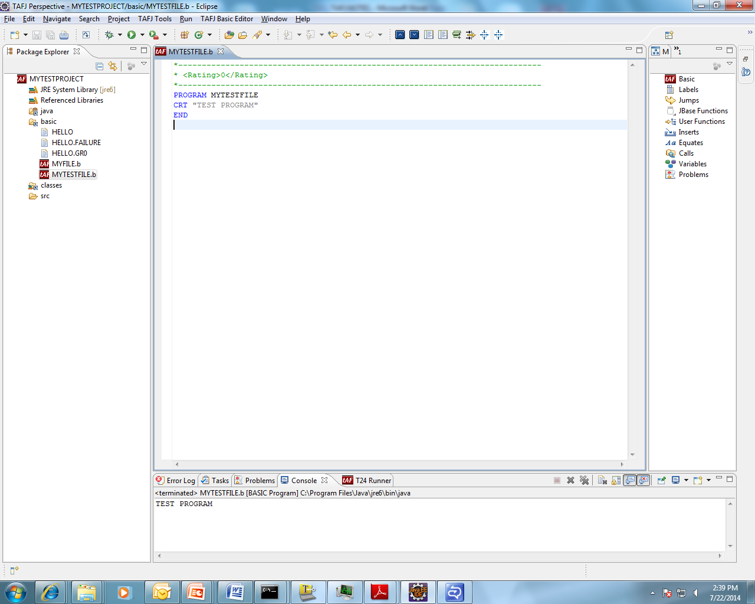
Eclipse – To write T24 routine

Slide 28
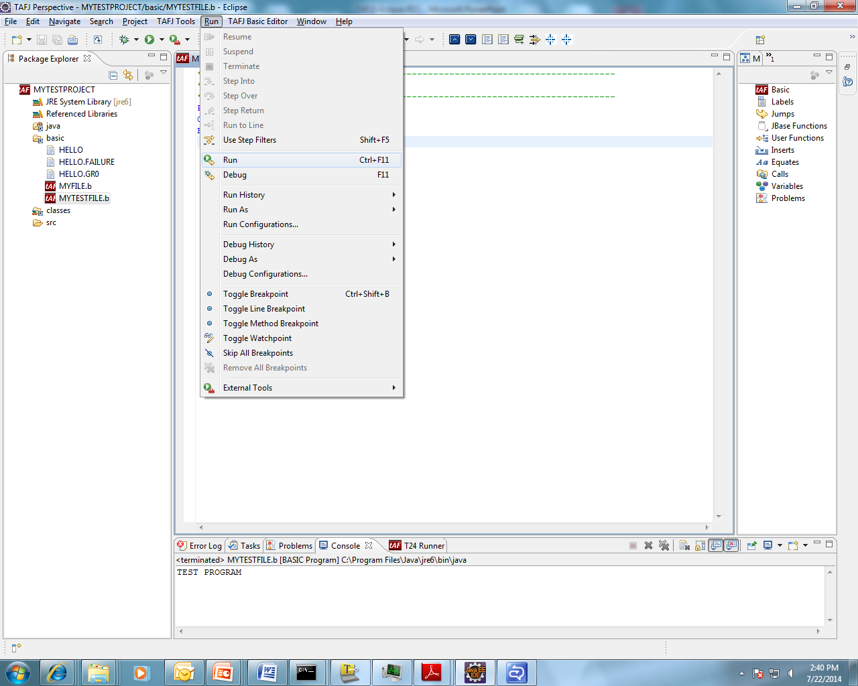
To execute the program

Slide 29
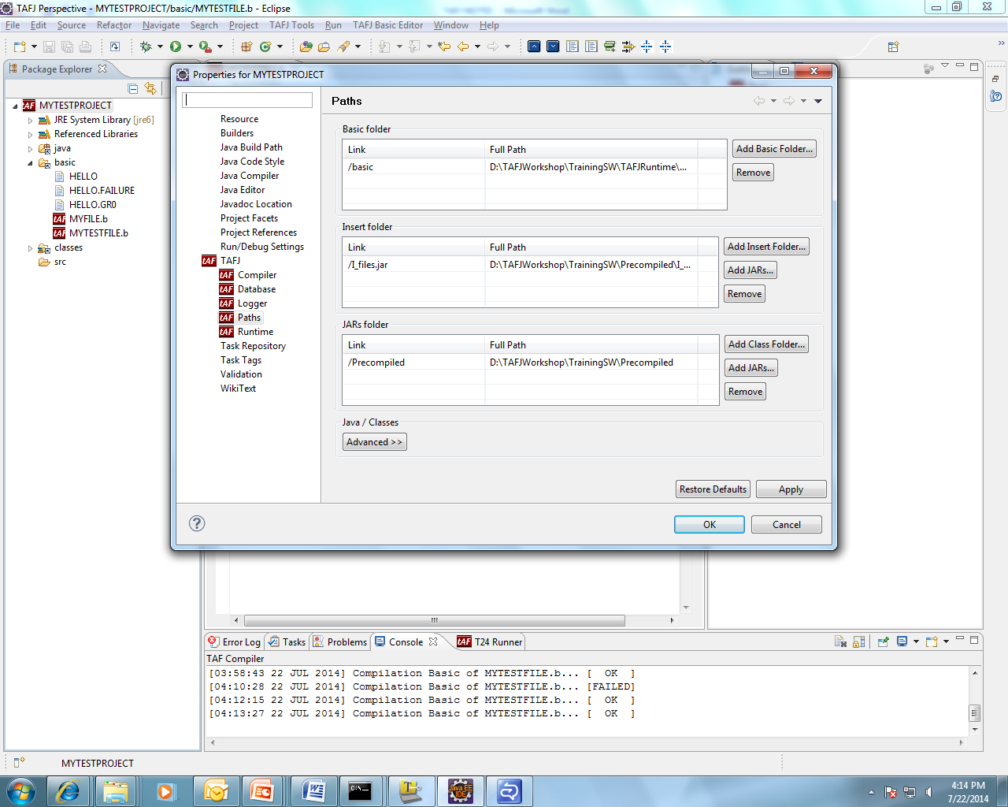
Eclipse
To use I_COMMON and I_EQUATE
Right click on project and click on properties and specify the path of Insert folder

Slide 30
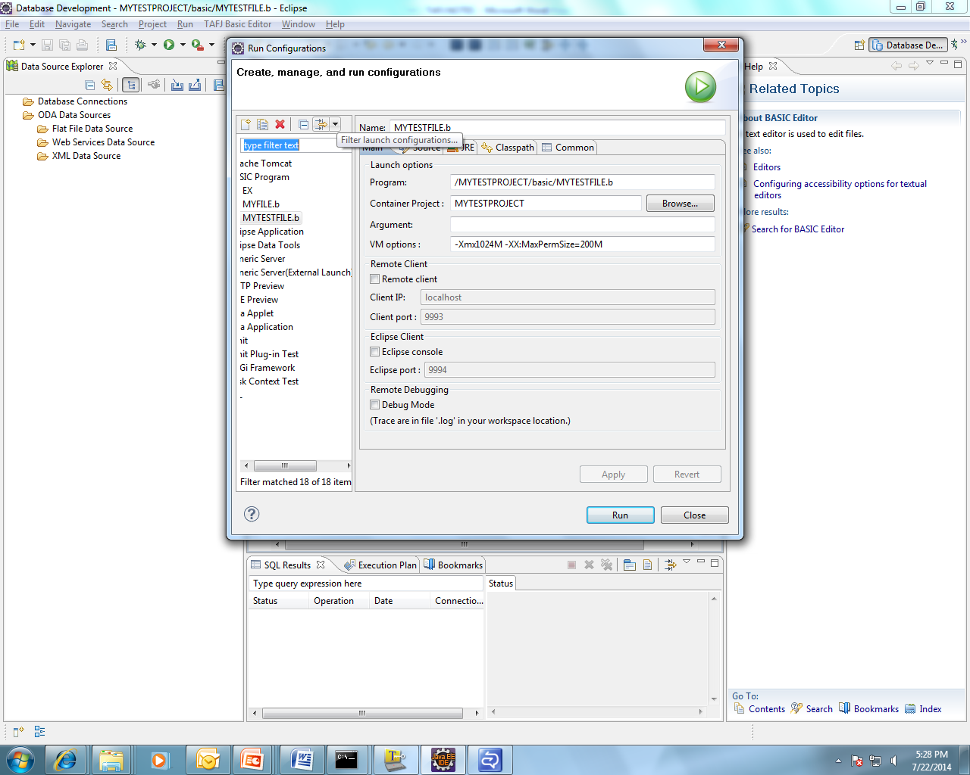
Eclipse
To invoke classic mode from eclipse
Go to Run menu click on Run configuration

Slide 31
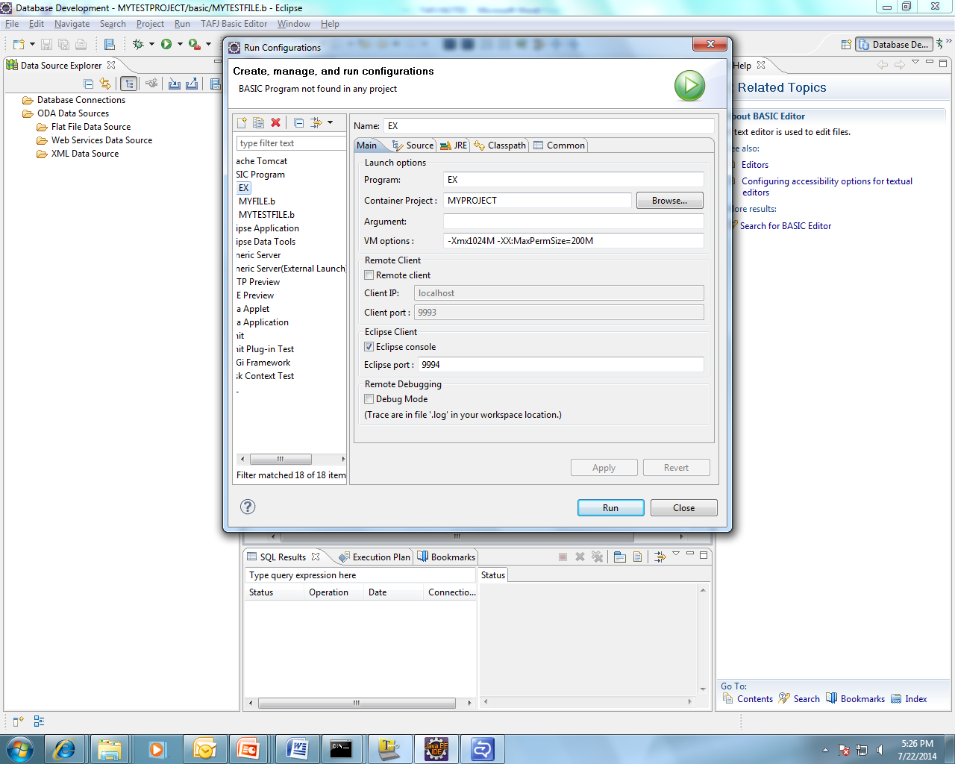
Eclipse

Slide 32
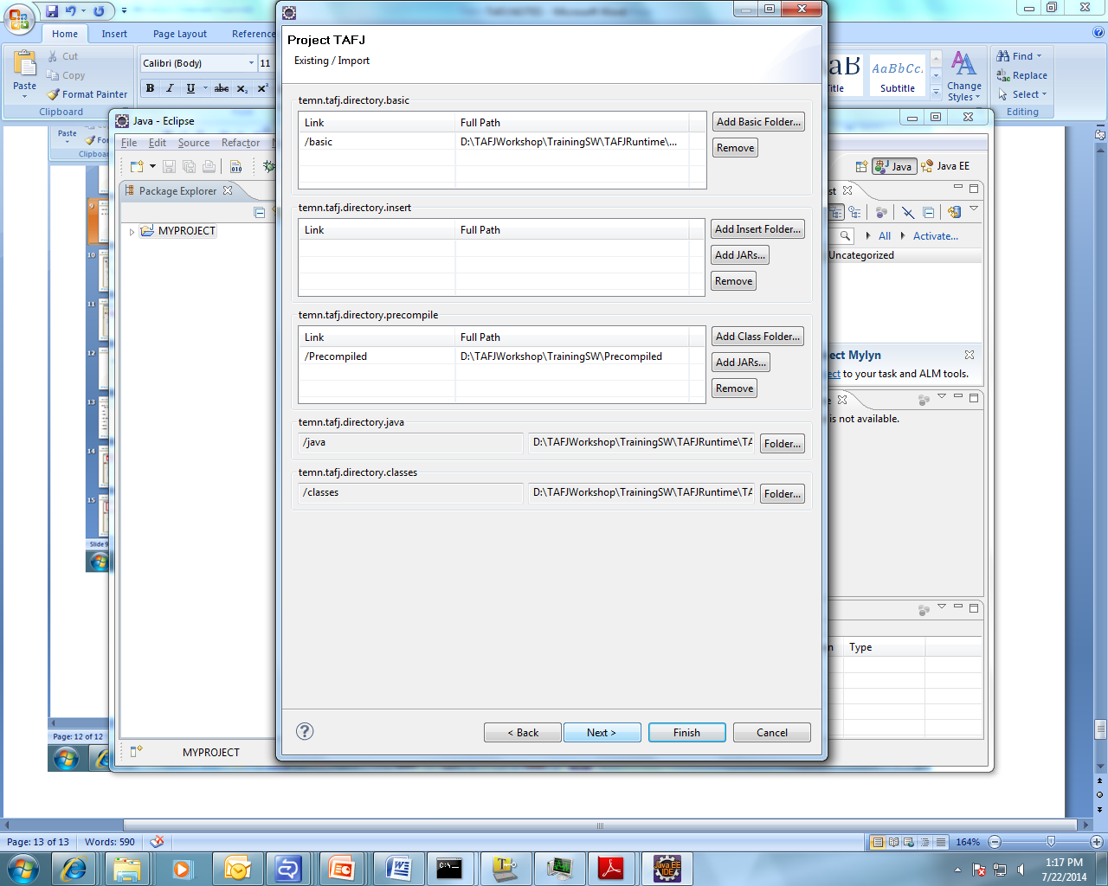
Eclipse

Slide 33
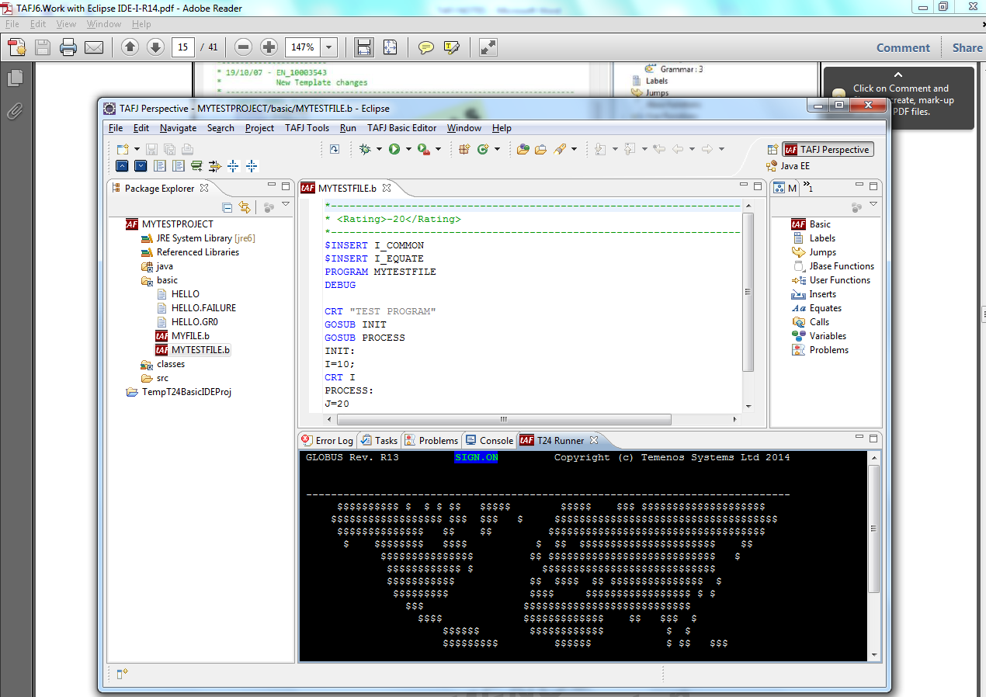
Eclipse

Slide 34
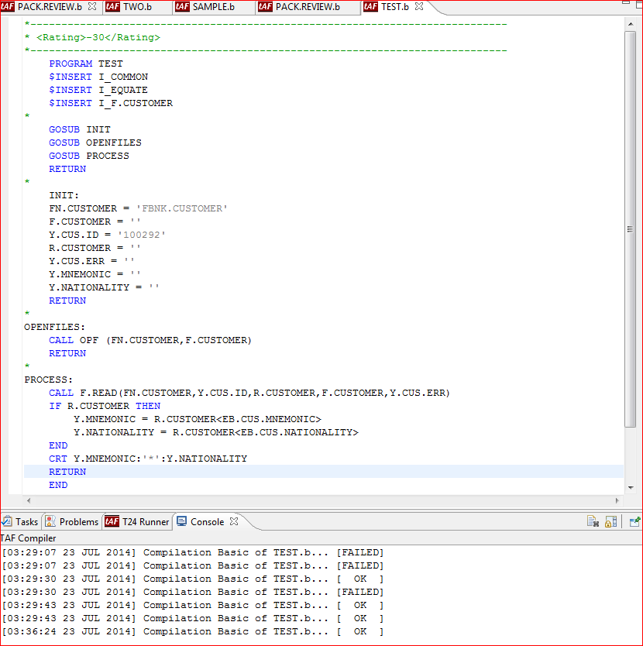
Using Debug in Eclipse

Slide 35
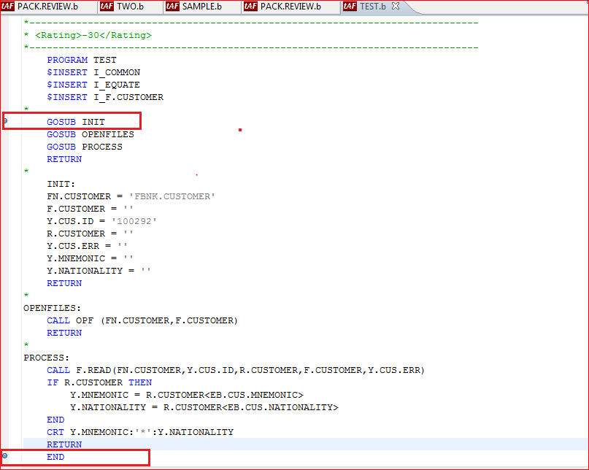
Using Debug in Eclipse

Slide 36
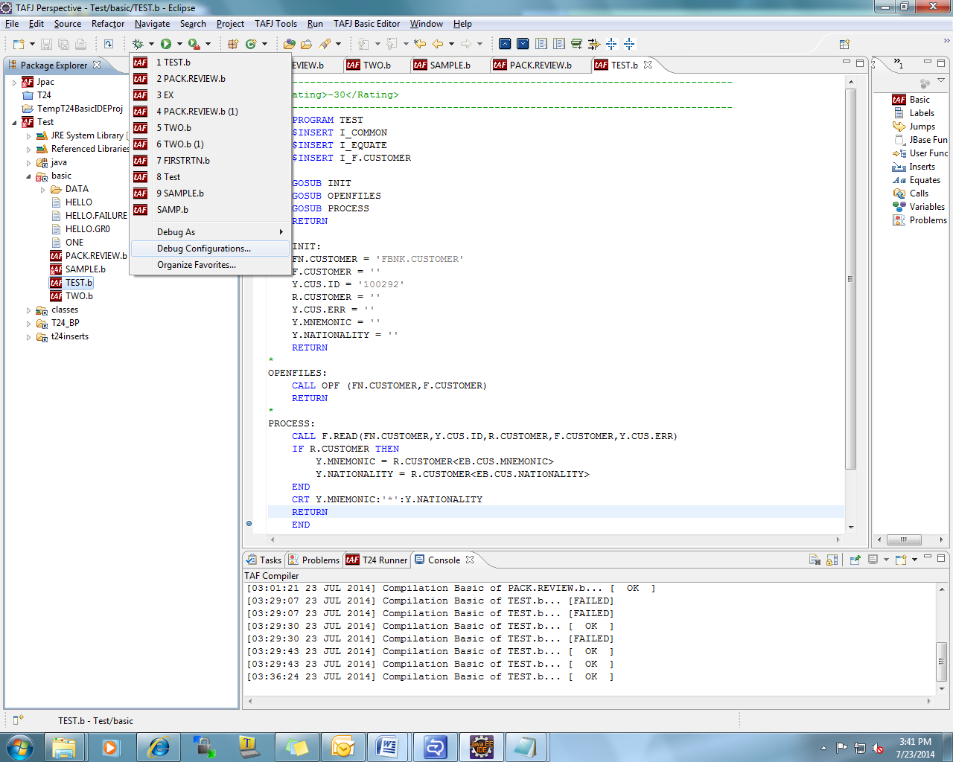
Using Debug in Eclipse

Slide 37
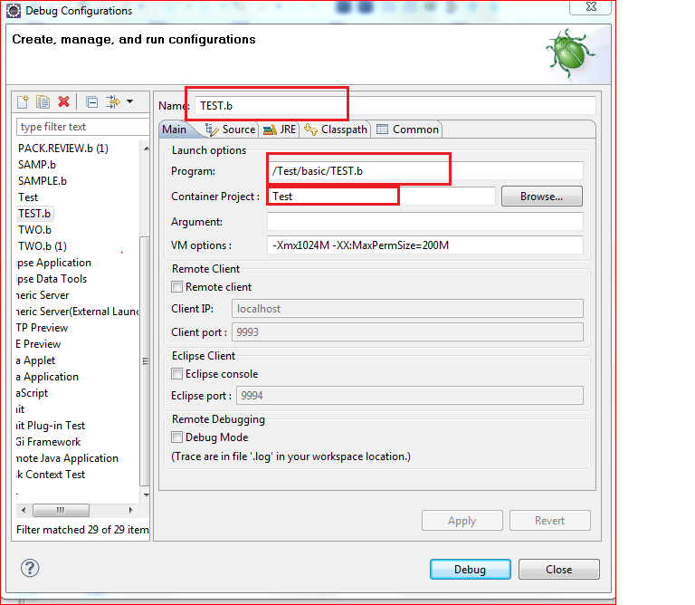
Using Debug in Eclipse

Slide 38
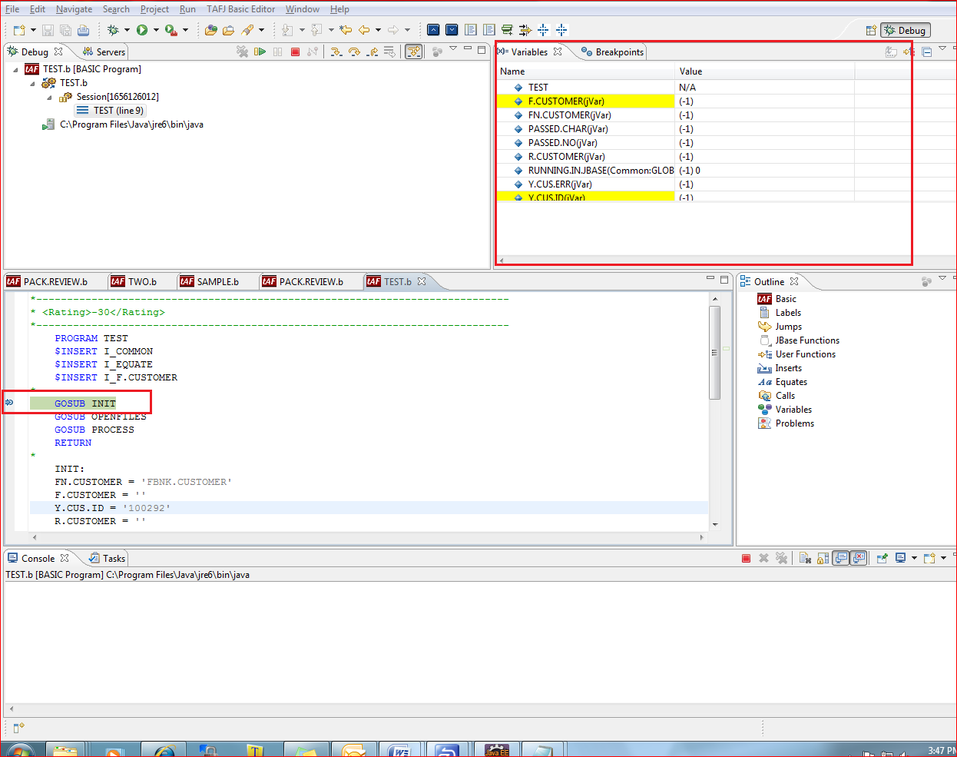
Using Debug in Eclipse

Slide 39
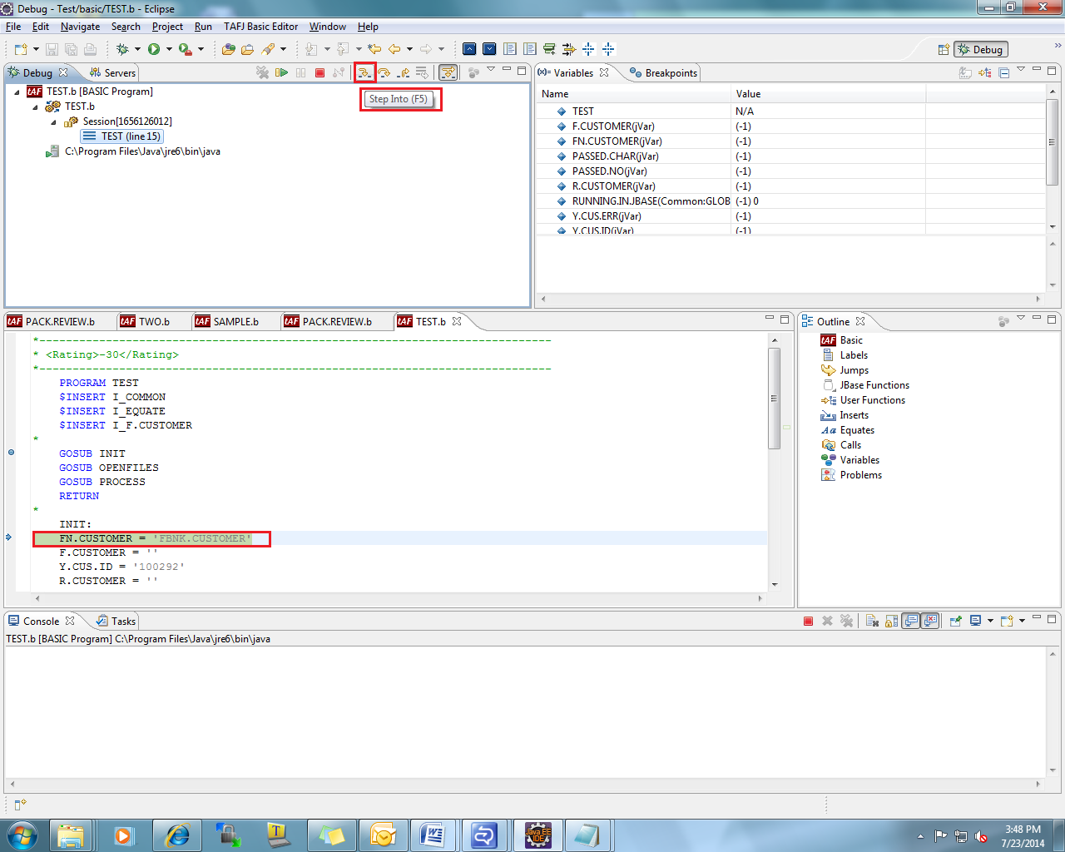
Using Debug in Eclipse

Slide 40
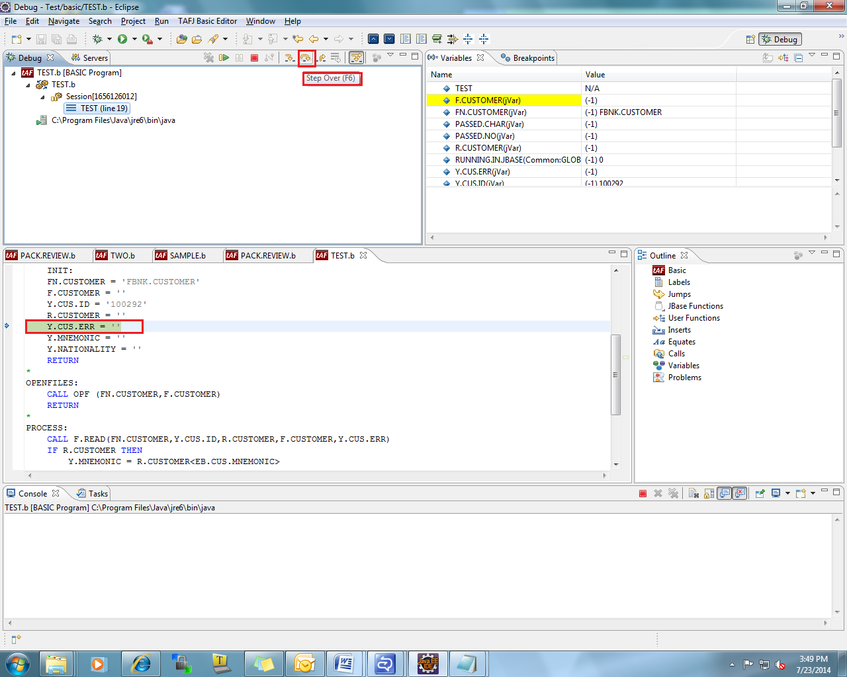
Using Debug in Eclipse

Slide 41
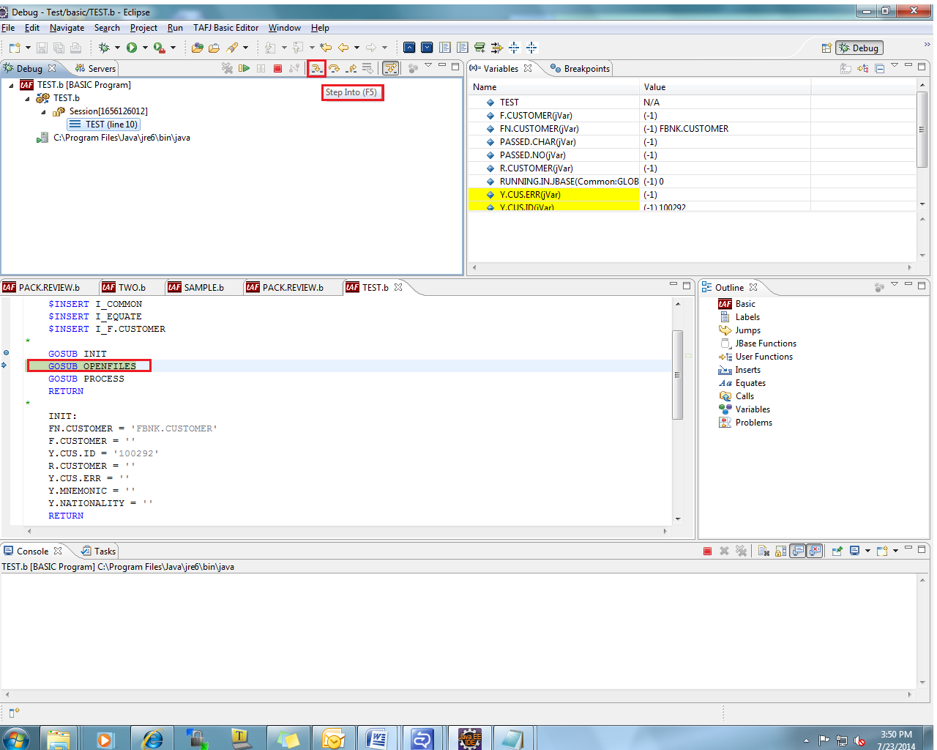
Using Debug in Eclipse

Slide 42
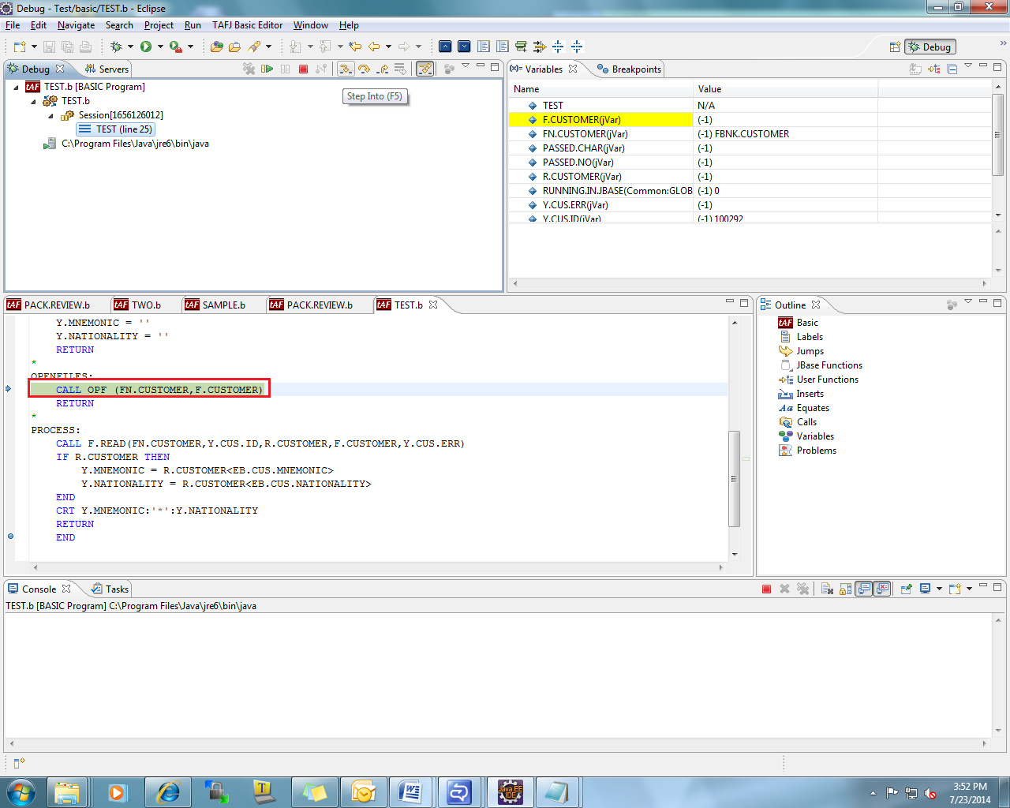
Using Debug in Eclipse

Slide 43
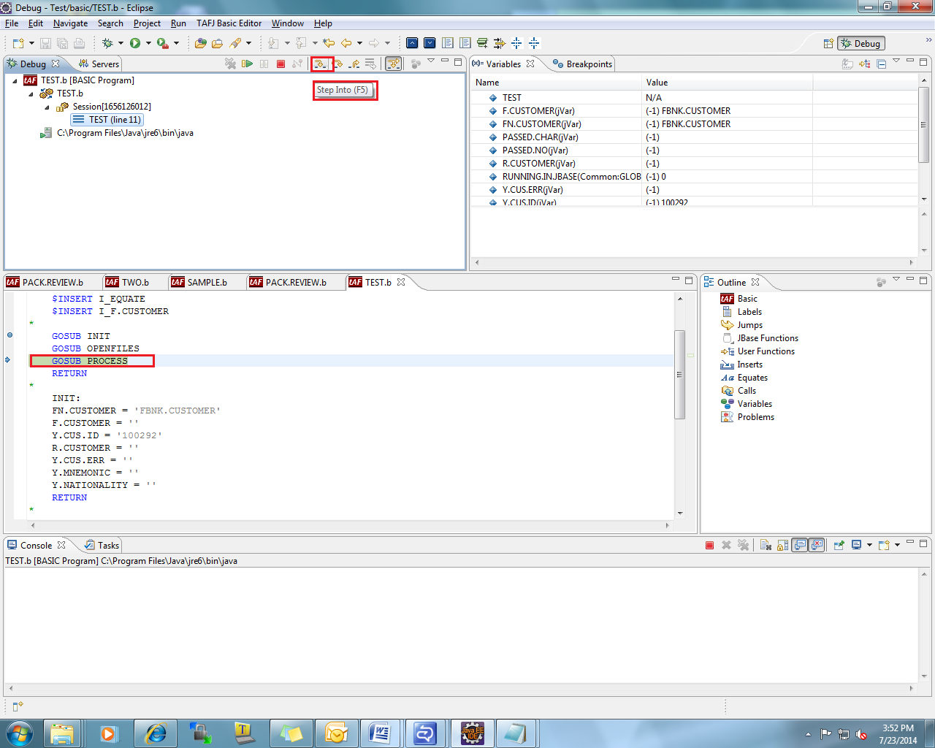
Using Debug in Eclipse

Slide 44
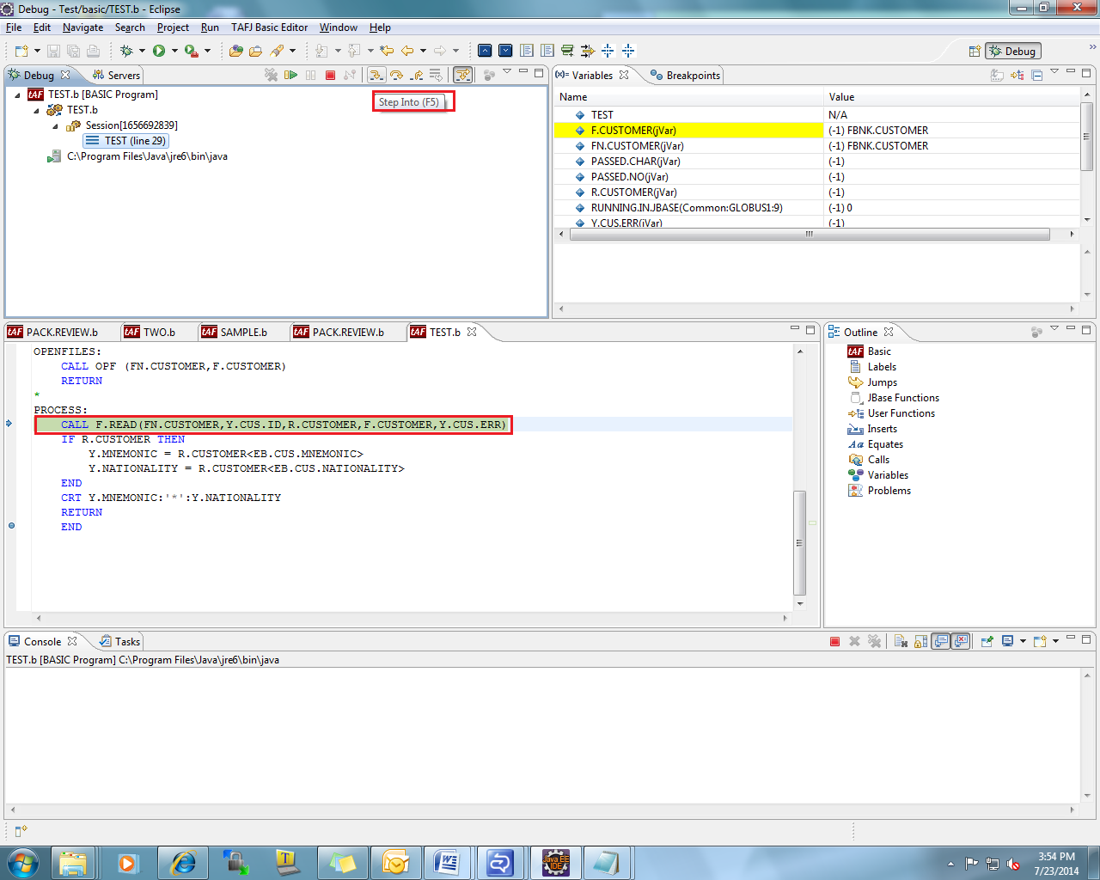
Using Debug in Eclipse

Slide 45
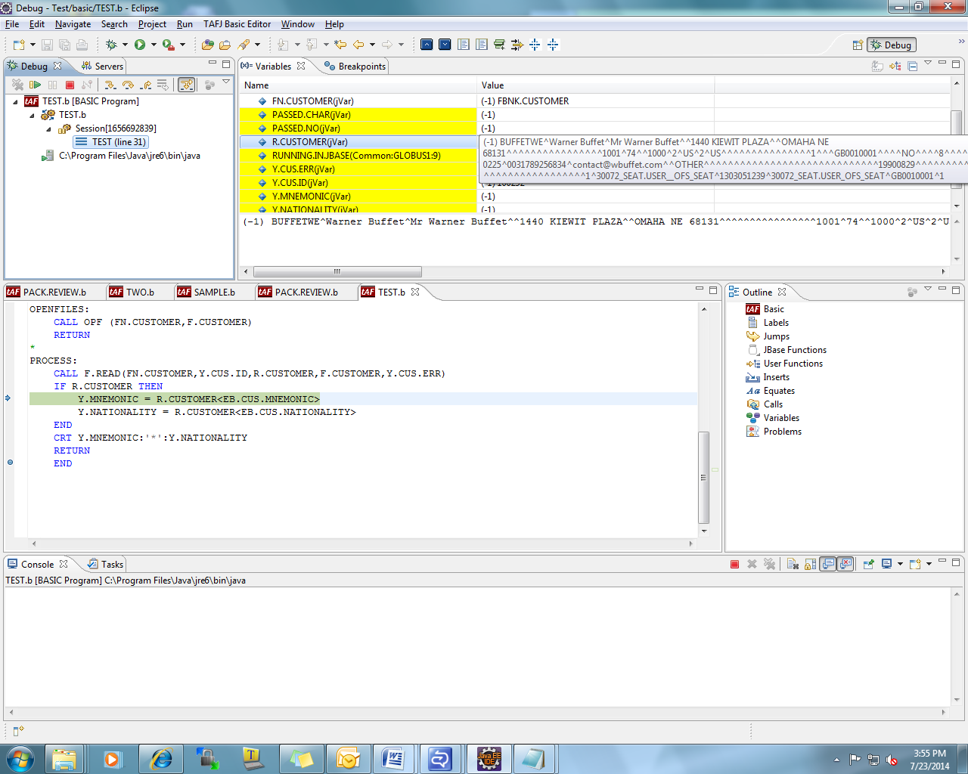
Using Debug in Eclipse

Slide 46
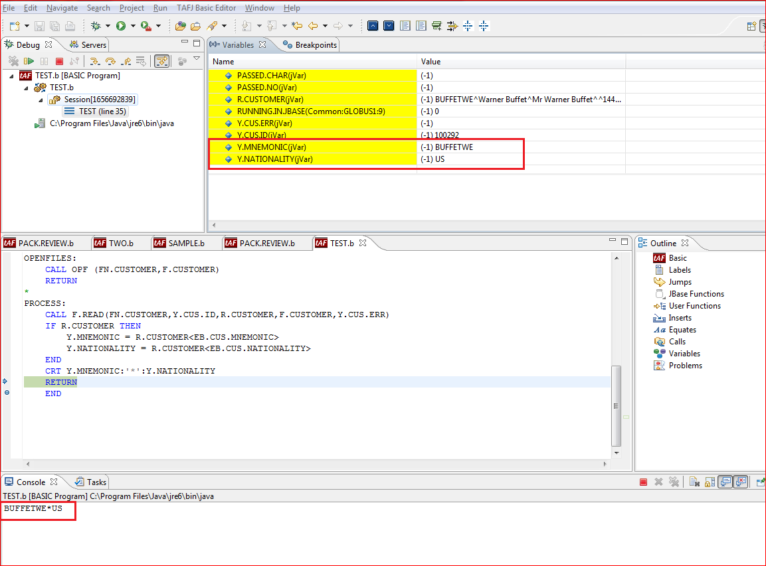
Using Debug in Eclipse

Slide 47
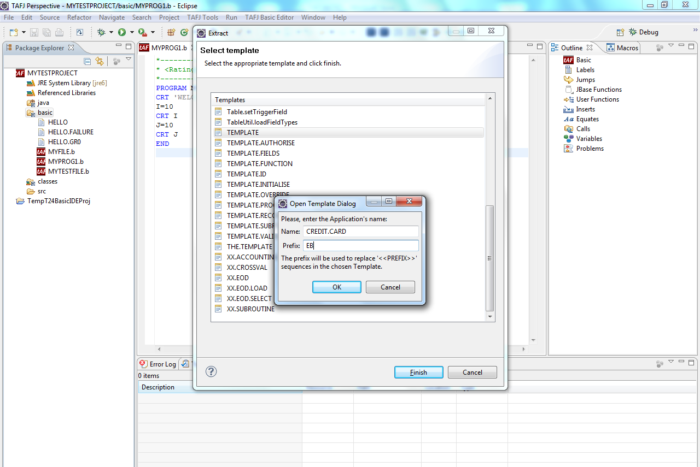
Adding Template to Routine

Slide 48
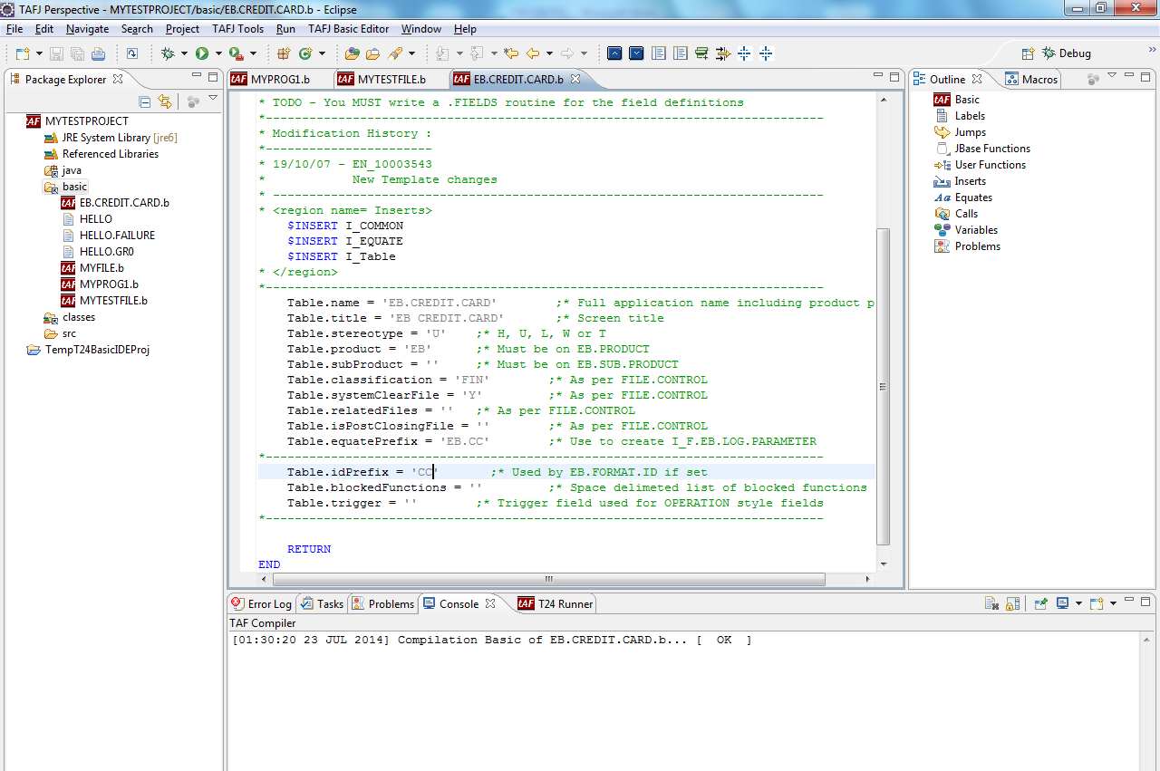
Adding Template to Routine

Slide 49
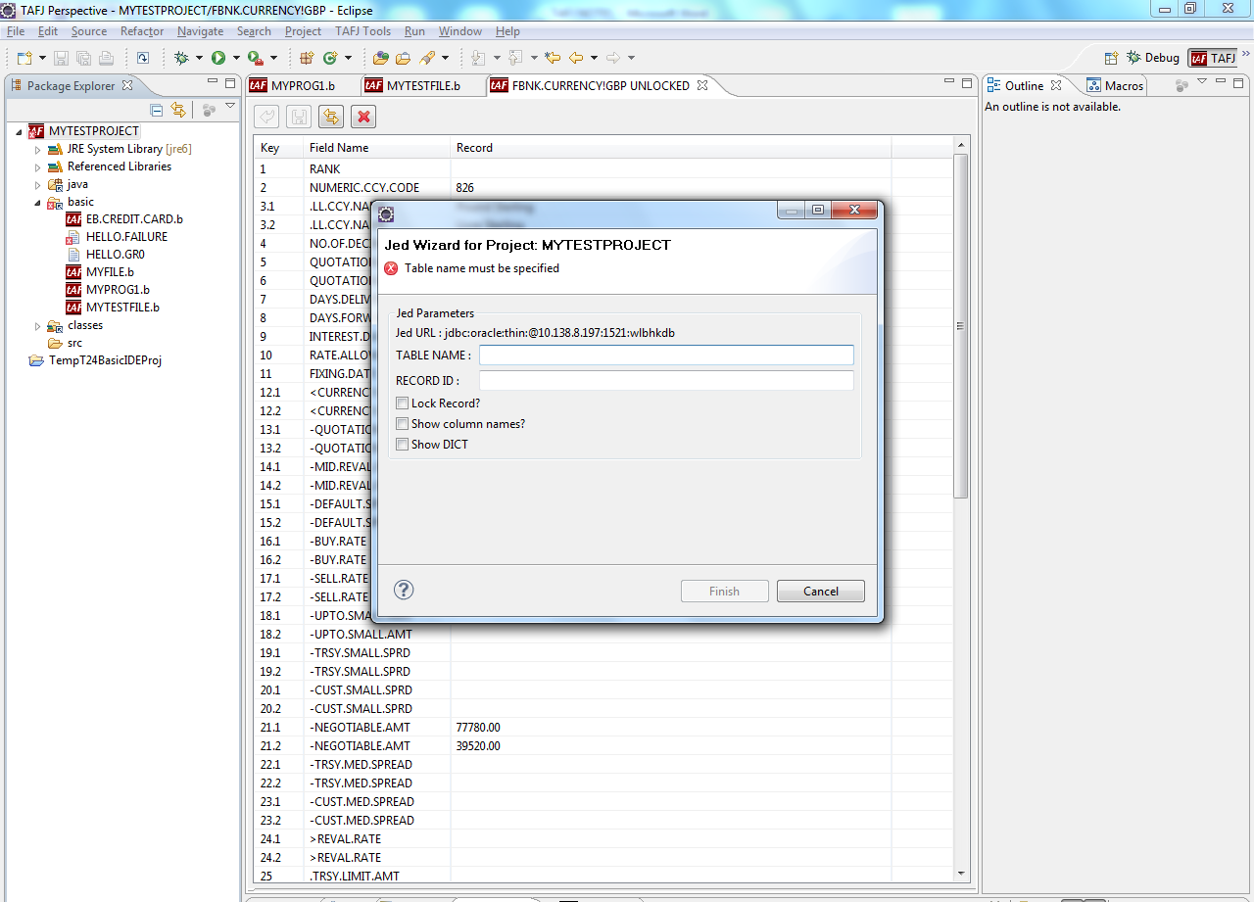
Open Jbase record from Eclipse
Right click on project and click on Jed Wizard

Slide 50
Open jbase record from Eclipse

Slide 51
Workshop
Create a TAFJ project with eclipse
Create a simple program with eclipse, compile it and analyze the generated class files and java files
Add a break point to your program and work with the debugging options available
Add a remote folder to your TAFJ project and perform a synchronization, modify one of the remote program locally and reflect the changes onto the remote program
Notes:
Create a TAFJ project with eclipse
Create a simple program with eclipse, compile it and analyze the generated class files and java files
Add a break point to your program and work with the debugging options available
Add a remote folder to your TAFJ project and perform a synchronization, modify one of the remote program locally and reflect the changes onto the remote program

Slide 52
Eclipse – A Review
Now, you should be able to:
Setup Eclipse
Add plug-in
Use Eclipse JED editor
Create Java projects in Eclipse
Use Eclipse plug-in features like
Outline View
Code rating
Expression Watch Point
Slide 51
Notes:
51
Now, you should be able to:
Setup Eclipse
Add plug-in
Use Eclipse JED editor
Create Java projects in Eclipse
Use Eclipse plug-in features like
Outline View
Code rating
Expression Watch Point

Slide 53


www.capgemini.com/financialservices

